Slide 1
Lesson 20:
Twitter API

Slide 2
Agenda for today’s class
Basic keyword search for tweets and user
Understand Twitter API
Installing Twitter Library
Posting Status on timeline
Step 1
Step 5
Step 6
15 mins
Step 1
Step 2
Step 3
Step 4
Step 7
Step 8
Getting Twitter API Keys
List user’s friends and Relationship between two users
Twitter Stream
What Next

Slide 3
Getting Twitter API keys

Slide 4
Getting Twitter API keys
To start with, we will need to have a Twitter account and obtain credentials
(i.e. API key, API secret, Access token and Access token secret) on the Twitter developer site to access the Twitter API, following these steps:
Create a Twitter user account if you do not already have one.
Go to https://apps.twitter.com/ and log in with your Twitter user account. This step gives you a Twitter dev account under the same name as your user account.
Click “Create New App”
Fill out the form, agree to the terms, and click “Create your Twitter application”
In the next page, click on “Keys and Access Tokens” tab, and copy your “API key” and “API secret”. Scroll down and click “Create my access token”, and copy your “Access token” and “Access token secret”.

Slide 5
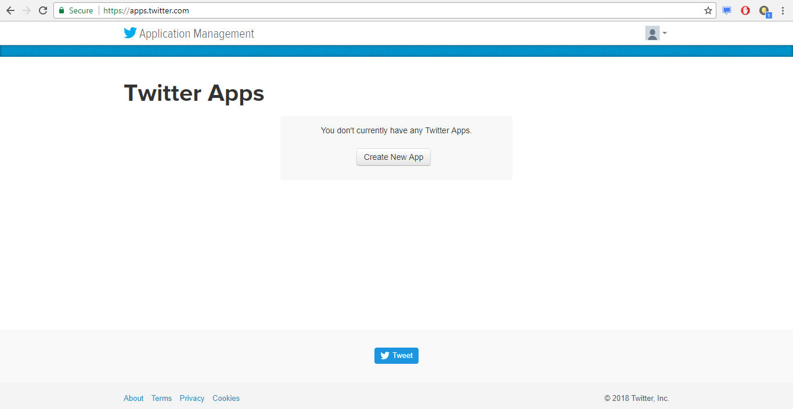

Slide 6
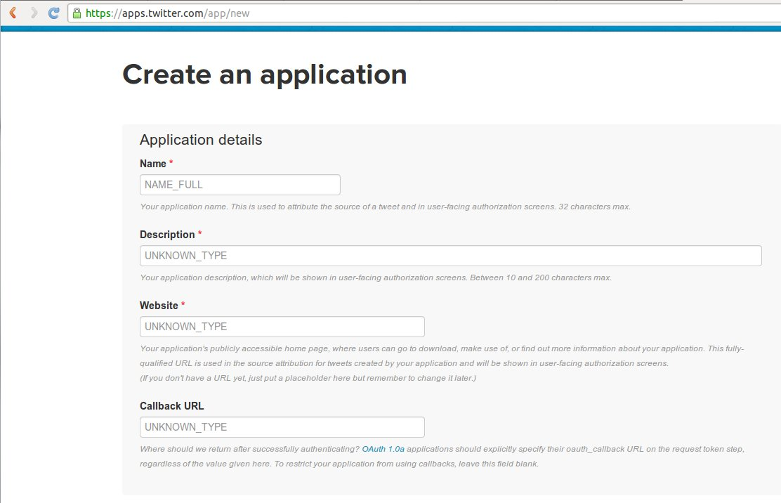

Slide 7
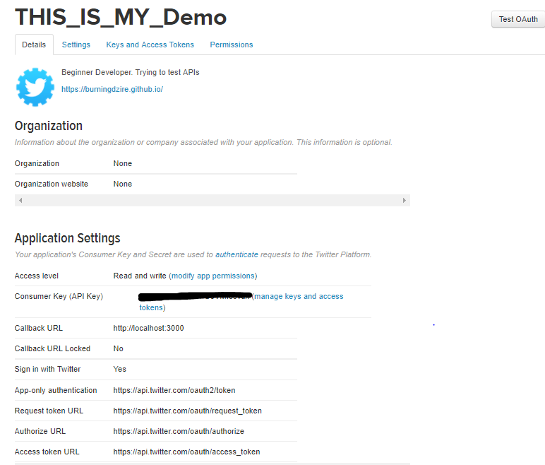

Slide 8
Installing a Twitter library

Slide 9
Installing a Twitter library
We will be using a Python library called Python-Twitter to connect to Twitter API and downloading the data from Twitter.
There are many other libraries in various programming languages that let you use Twitter API. We choose the Python-Twitter, because it is simple to use yet fully supports the Twitter API.
Download the Python Twitter tools at https://pypi.python.org/pypi/twitter.

Slide 10
Making config.py

Slide 11
Making config.py
First we will create a file named 'config.py'.
Inside this file we will store all the configurations
Consumer key(API Key),
Consumer Secret key(API Secret key),
Access key and
Access Secret key.
We are doing this so that we can import all the configurations in one file. Now in case we change our API Keys and Access keys in future, we just need to change the config file.
consumer_key = "XxXxXxxXXXxxxxXXXxXX"
consumer_secret = "xXXXXXXXXxxxxXxXXxxXxxXXxXxXxxxxXxXXxxxXXx"
access_key = "XXXXXXXX-xxXXxXXxxXxxxXxXXxXxXxXxxxXxxxxXxXXxXxxXX"
access_secret = "XxXXXXXXXXxxxXXXxXXxXxXxxXXXXXxXxxXXXXx"

Slide 12
Lists all of user's friends

Slide 13
Lists all of a given user's friends
Now let’s create another file named 'twitter-friends.py'.
This code will outputs list of friends of the users.
from twitter import *
import twitter_config as tc
oauth = OAuth(tc.access_key, tc.access_secret, tc.consumer_key, tc.consumer_secret)
twitter = Twitter(auth = oauth)
username = "_burningdzire"
query = twitter.friends.ids(screen_name = username)
print("found %d friends" % (len(query["ids"])))
for n in range(0, len(query["ids"]), 100):
ids = query["ids"][n:n+100]
subquery = twitter.users.lookup(user_id = ids)
for user in subquery:
print(" [%s] %s - %s" % ("*" if user["verified"] else " ", user["screen_name"], user["location"]))

Slide 14
Relationship between two users

Slide 15
Relationship between two users
Now let’s create another file named 'twitter-friendship.py'.
This code will outputs details of the relationship between two users.
from twitter import *
import twitter_config as tc
oauth = OAuth(tc.access_key, tc.access_secret, tc.consumer_key, tc.consumer_secret)
twitter = Twitter(auth = oauth)
source = "_burningdzire"
target = "chetan_bhagat"
result = twitter.friendships.show(source_screen_name = source,target_screen_name = target)
following = result["relationship"]["target"]["following"]
follows = result["relationship"]["target"]["followed_by"]
print("%s following %s: %s" % (source, target, follows))
print("%s following %s: %s" % (target, source, following))

Slide 16
Performs a basic keyword search for tweets containing the keywords

Slide 17
Performs a basic keyword search for tweets containing the keywords
Now let’s create another file named 'twitter-search.py'.
This code will performs a basic keyword search for tweets containing the keywords.
from twitter import *
import twitter_config as tc
oauth = OAuth(tc.access_key, tc.access_secret, tc.consumer_key, tc.consumer_secret)
twitter = Twitter(auth = oauth)
query = twitter.search.tweets(q = "india")
print("Search complete (%.3f seconds)" % (query["search_metadata"]["completed_in"]))
for result in query["statuses"]:
print("(%s) @%s %s" % (result["created_at"], result["user"]["screen_name"], result["text"]))

Slide 18
Displays a user's current timeline.

Slide 19
Displays a user's current timeline.
Now let’s create another file named 'twitter-user-timeline.py'.
This code will displays a user's current timeline.
from twitter import *
import twitter_config as tc
oauth = OAuth(tc.access_key, tc.access_secret, tc.consumer_key, tc.consumer_secret)
twitter = Twitter(auth = oauth)
user = "Google"
results = twitter.statuses.user_timeline(screen_name = user)
for status in results:
print("(%s) %s" % (status["created_at"], status["text"].encode("ascii", "ignore")))

Slide 20
Performs a search for users
matching a certain query

Slide 21
Performs a search for users matching a certain query
Now let’s create another file named 'twitter-user-search.py'.
This code will performs a search for users matching a certain query.
from twitter import *
import twitter_config as tc
oauth = OAuth(tc.access_key, tc.access_secret, tc.consumer_key, tc.consumer_secret)
twitter = Twitter(auth = oauth)
results = twitter.users.search(q = 'India')
for user in results:
print("@%s (%s): %s" % (user["screen_name"], user["name"], user["location"]))

Slide 22
Getting Twitter Stream

Slide 23
Connecting to Twitter Streaming APIs
The Streaming APIs give access to all tweets as they published on Twitter. On average, about 6,000 tweets per second are posted on Twitter and we will get a small proportion (<=1%) of it.
The Streaming APIs are one of the two types of Twitter APIs. The other one called REST APIs , which is more suitable for singular searches, such as searching historic tweets, reading user profile information, or posting Tweets. The Streaming API only sends out real-time tweets, while the Search API (one of the popular REST APIs) gives historical tweets up to about a week with a max of a couple of hundreds. You may request elevated access (e.g. Firehose, Retweet, Link, Birddog or Shadow) for more data by contacting Twitter’s API support.

Slide 24
Connecting to Twitter Streaming APIs
import json
from twitter import *
import twitter_config as tc
oauth = OAuth(tc.access_key, tc.access_secret, tc.consumer_key, tc.consumer_secret)
twitter = TwitterStream(auth = oauth)
iterator = twitter.statuses.sample()
tweet_count = 1000
for tweet in iterator:
tweet_count -= 1
print(json.dumps(tweet))
if tweet_count <= 0:
break

Slide 25
Posts a status message to your timeline

Slide 26
Posts a status message to your timeline
Now let’s create another file named 'twitter-post-status.py'.
This code will posts a status message to your timeline
from twitter import *
import twitter_config as tc
oauth = OAuth(tc.access_key, tc.access_secret, tc.consumer_key, tc.consumer_secret)
twitter = Twitter(auth = oauth)
new_status = "Hola mi amigo"
results = twitter.statuses.update(status = new_status)
print "updated status: %s" % new_status

Slide 27
So what next?

Slide 28
Let’s check it out
https://developer.twitter.com/

Slide 29
We’ll continue in next class..
Any questions?

